Slide 2
What is Honors?
Honors education ignites passion for lifelong learning and encourages student creativity, collaboration, and leadership in the classroom and beyond.

Slide 3
What is NCHC?
Founded in 1966, the National Collegiate Honors Council (NCHC) is a unique educational organization designed to support and promote undergraduate honors education. NCHC has nearly 900 member institutions and several hundred individual members, impacting over 330,000 honors students.

Slide 4
Characteristics of Honors
Honors education is characterized by in-class and extracurricular activities that are measurably:
Broader
Deeper
More Complex…
…than comparable learning experiences typically found
at institutions of higher education.

Slide 5
Learning Environment
Inventive and experiential education
Learner-directed environment
Opportunities that are appropriately tailored to fit the institution's culture and mission
Occur within a close community of students and faculty.
Notes:
NCHC is committed to modeling best practices in inclusion, and to using inclusive leadership strategies, research, and partnerships with other organizations to help honors colleges and programs pursue honors practices and programs that serve and empower all communities.

Slide 6
What is a College and a Program?
College
Program
Organized
Faculty
Advisement
Controlled and Focused
Smaller
Operates under a College (Subgroup or Division)
Access limited based on college partner

Slide 7
What does an Honors Student do?
What is an “honors class”?

Slide 8
Reading and Writing
Research

Slide 9
Topic Focus Capstone

Slide 10
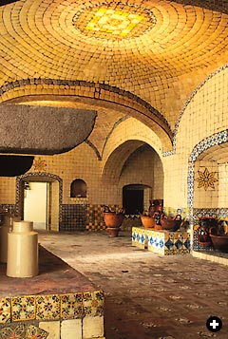
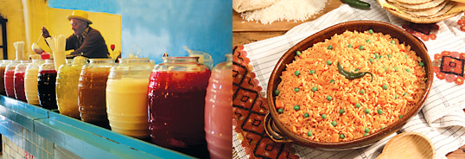
Writing Assignment
Creating the Question
Following Up with an Answer

Slide 11
Writing Assignment
Creating the Question
Following Up with an Answer

Slide 12
Break Into Groups

Slide 13
Levels of Questions
High School
College
Mole is a traditional Mexican dish made of varies spices.
Simple, gets to the point, sets up conclusion and direction
Question:
Why is mole important?
How was mole first introduced?
Mole has a unique flavor and color palette that is distinctive to a region in Mexico
Allows for references, open to further expansion, incorporates numbers and supportive details
Question:
Why do different moles have different colors?
How do moles differ between traditional Mexican cuisine and that of Mexican-American cuisine?

Slide 14
Levels of Questions
Honors College
Stew based cuisine can illustrate migration of people and their natural resources between areas in Asia, Middle East and the New World (The Americas). This can provide support of variate types of chile strands across the silk trade route, conquistadores of the Americas through El Camino Rael.
Direction, creativity, referencing and mastery
Question:
How can mole provide a cultural and agricultural migration map?
How has mole recipes translate from indigenous communities through main stream and fusion culinary trends?

Slide 15
Each Group: 1 Subject Card Create a Honors Question and The Answer
Provide enough time to complete task
20 minutes for general groups

Slide 16
Have Groups Share Their Question and Answers Provide Guidance and Follow Up Questions

Slide 17
Prompt: Describe what issue, challenge or conflict in the world needs to be changed and why; and describe how you would use your strengths and passion to make the change happen.

Slide 18
Honors Colleges and Programs
Top Honors
Local and Regional
Arizona State, Barrett Honors College
City University of New York (CUNY), Macaulay Honors College
Florida Atlantic University, Wilkes Honors College
Kansas University Honors Program
Penn State, Schreyer Honors College
UNM Honors College
CNM Honors Program
NMSU Honors College
WNMU Honors Program
NMHU Honors Program

Slide 20
Leadership, Learning & Research Environment
Student Associations & Experiences
Admission

Slide 21
Deeper Learning
Broader Learning
More Complex Learning
Notes:
Broader Learning:
Interdisciplinarity and Connections
Deeper Learning:
Disciplinary Depth and Rigor
More Complex Learning:
Not remember or understand, but rather
Solve real-world problems
Create new ideas/systems
Invent the unimaginable

Slide 22
Deeper Learning
NOT like high school AP or Honors classes
Small, seminar-style courses
Research Focused
Capped at 18 students

Slide 23
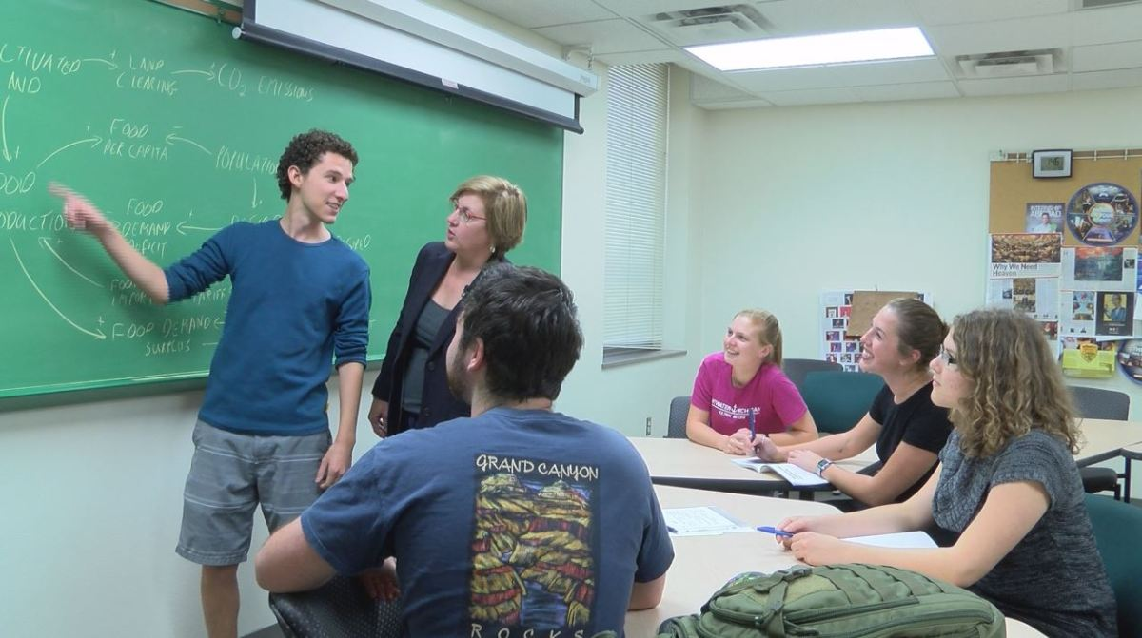
Broader Learning
Substantive non-traditional assignments
Interdisciplinary Students & Classes

Slide 24
More Complex Learning
High-Impact Courses
Inquiry-based Problem Solving
Critical and Creative Thinking

Slide 25
Academic Life
Legacy
Faculty
Graduating with Honors

Slide 26
Legacy & Courses
Sem: Legacy of Darwin's Great Idea
Sem: Legacy of Comedy
Sem: Legacy of Failure
Sem: Legacy of Rebellion
Sem: Legacy of Science & Society
Sem: Legacy of Monster & Marvels through the Ages
Sem: Legacy of Success
Sem: Rhetoric & Discourse: Poetry & Comics
Sem: Mathematics in the World: Statistics
Sem: Science in 21st Century: Physics is Everywhere
Sem: Indiv & Collective: Keeping the Peace
Sem: Fine Art: Musical Theatre is Everywhere
Sem: Publication Process (Scribendi Part 1)
Sem: Food and Society
Sem: World Building

Slide 27
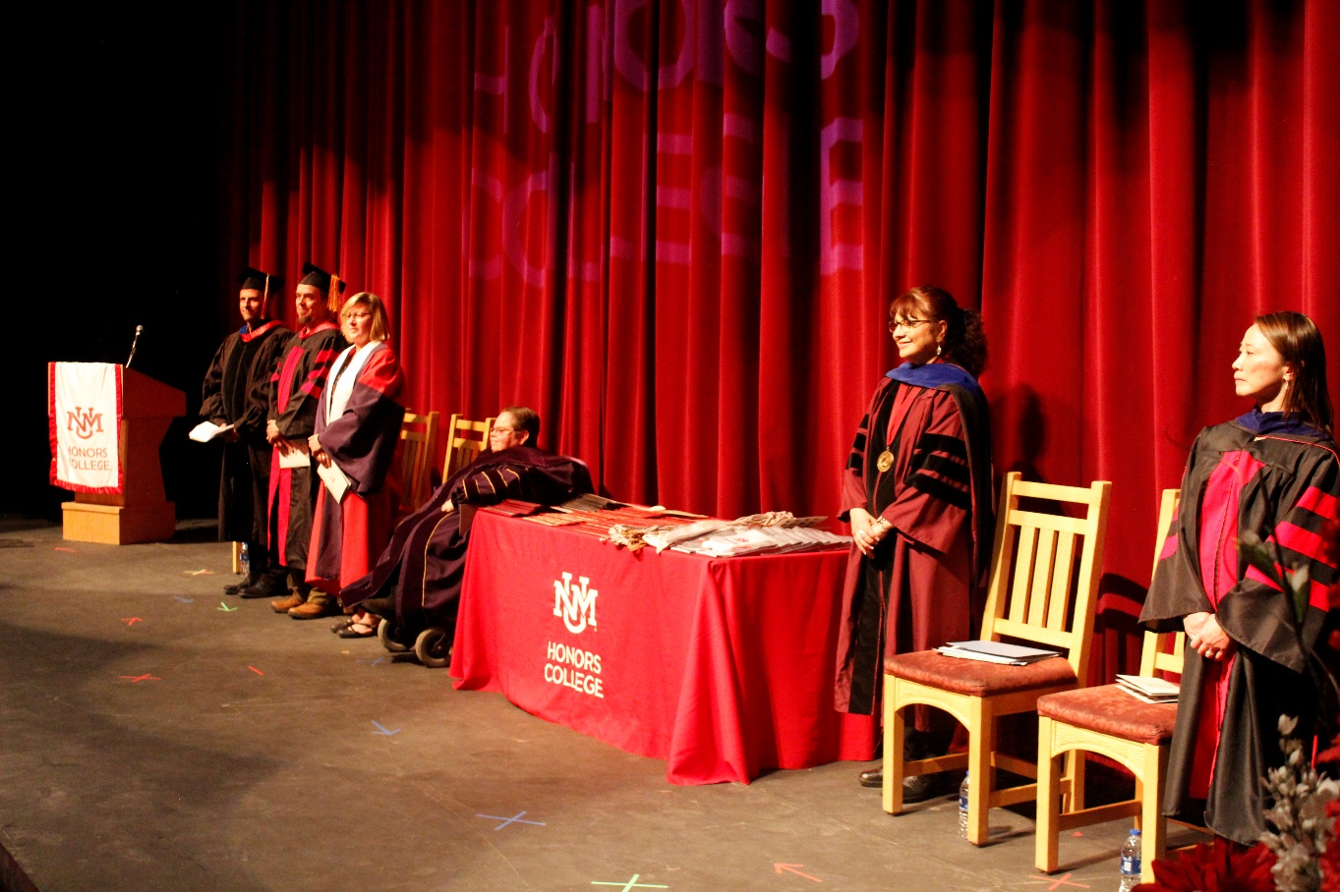
Faculty

Slide 28
Graduating with Honors
120 CREDITS TO GRADUATE
Honors Minor: 24 credits
Honors Designation: 15 credits (5 classes)

Slide 29
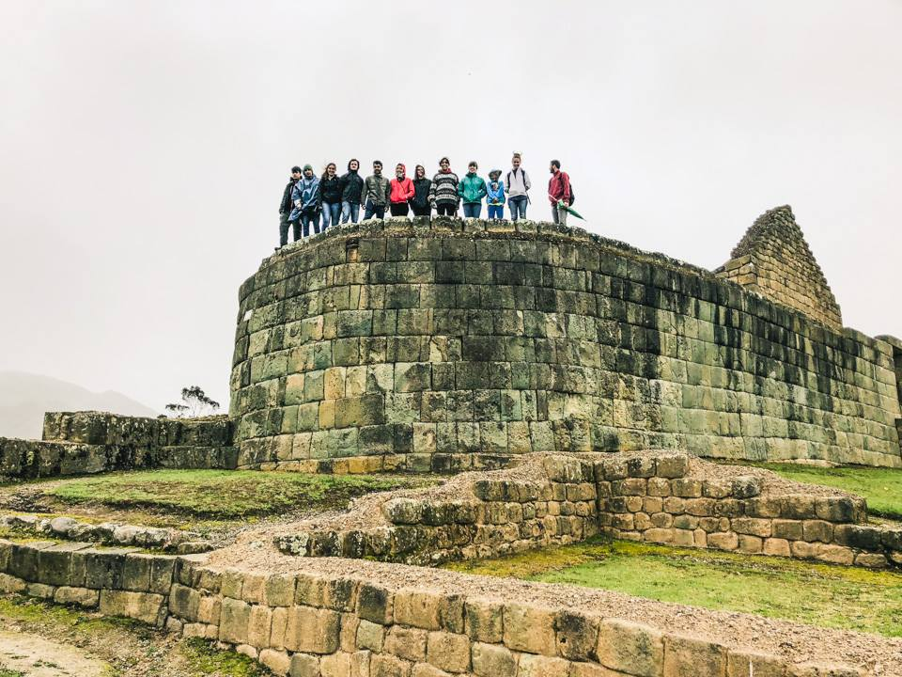
Student Associations & Experiences
Notes:
400 plus
Student created, student driven, student funded
Student Associations and Experiences
Study Aboard
Housing

Slide 30
HONORS STUDENT ASSOCIATION
@UNMHSA
@UNMHSA
@HSAUNM
Notes:
INVITE KIYOKO FOR CAELD

Slide 31
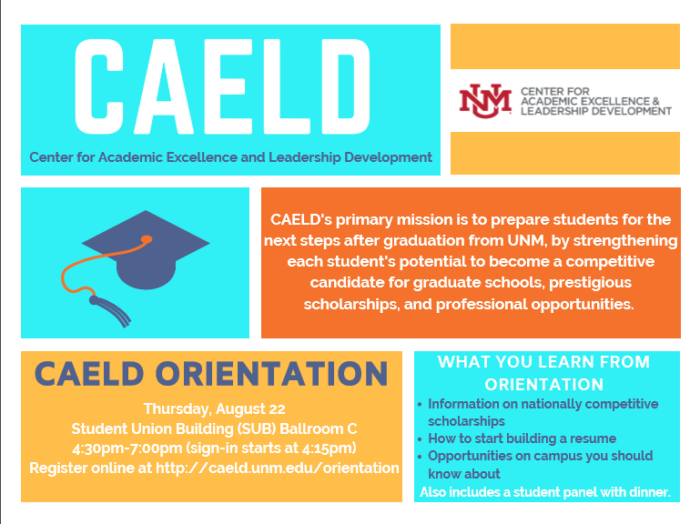
CAELD: Center for Academic Excellence & Leadership Development
Dr. Kiyoko Simmons Honors College
caeld@unm.edu
505-277-0428
CAELD.unm.edu.
caeld.unm.edu
Notes:
CAELD is an one-stop office for high achieving students to help them prepare for the next step after graduating from UNM.
CAELD coordinates 12+ prestigious scholarships (listed on the back of the CAELD postcard). These are not just for money, but also for recognition to validate your achievements. I usually mention about Rhodes Scholarship which is the most prestigious award American college students can apply. If you become a Rhodes Scholar, you will study at the Oxford for two years for free!
Resume building – use three summers wisely and focus on academic excellence, leadership development, service activity, and research experience during the next four years. Choose activities to help you get your dream job.
Come to the orientation and find out more about scholarships and opportunities. They can register online at http://caeld.unm.edu/orientation.

Slide 32
SCRIBENDI
Get published in an award-winning magazine!
Scribendi is the national literature and arts magazine for Honors students that is created here at UNM’s Honors College.
Scribendi publishes the following categories:
creative nonfiction
short fiction
poetry
photography
visual art
open media
foreign language
scribendi.unm.edu

Slide 33
Study Aboard
International exchange
National exchange
Notes:
150 world wide
160 states side

Slide 34
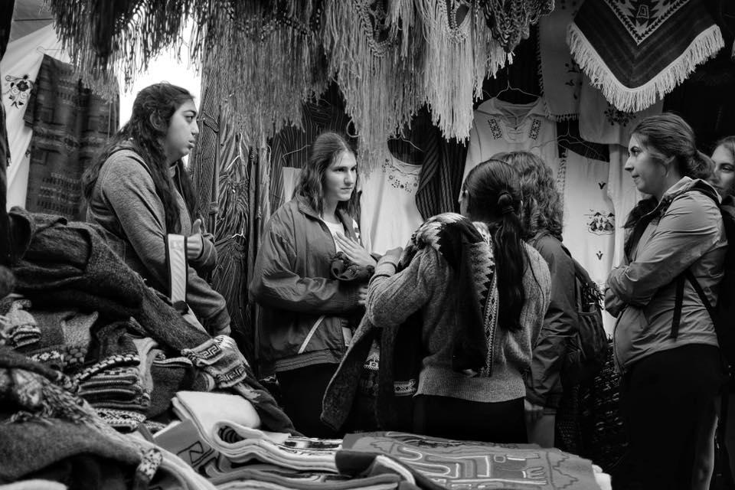
CONEXIONES
honors.unm.edu/conexiones
Notes:
INVITE ALYSSA OR HYUNJU FOR SCRIBENDI

Slide 35
Admission

Slide 36
Admission to UNM Honors College
General Admission
Honors College Application
Requirements
Deadlines

Slide 37
Admission to UNM Honors College
Beg Fresh
Current UNM/Transfer Student
3.5+ G.P.A. (unweighted)
ACT 28+
SAT 1320+
Minimal 12 credit hours completed
WITH
3.2 overall GPA

Slide 38
Cost of Attendance
Estimated Costs Full-Time | Resident | Non-Resident
Tuition & Fees | $7,322.00 | $22,586.00
Room & Board - Traditional | $9,864.00 | $9,864.00
Books & Supplies | $1,126.00 | $1,126.00
Transportation | $1,892.00 | $1,892.00
Miscellaneous | $2,124.00 | $2,124.00
Total | $22,328.00 | $37,592.00

Slide 39
Scholarships – New Mexico Resident
Name | Deadline | Amount | Criteria for Consideration
Regents | December 1 | $18,803/Year | 31 ACT/1390 SAT & 3.9 GPA
National Scholar | February 1 | $18,803/Year | Selected National Merit Finalist
National Hispanic & American Indian Scholar | February 1 | $8,951/Year | Selected National Hispanic or American Indian Scholar
Presidential | December 1 | $9,147/Year | 25 ACT/1200 SAT & 3.75 GPA
Woodward | December 1 | $8,292/Year | 29 ACT/1330 SAT & 3.5 GPA
UNM Scholar | December 1 | $7,532/Year | 26 ACT/1230 SAT & 3.5 GPA
Bridge to Success | December 1 | $1,500 1st Semester | 23 ACT/1130 SAT & 3.0 GPA
Success Grant | March 1 | $1,000 1st Semester | 2.5 GPA & Completed FAFSA
Notes:
1 year living
Graduating from NM high school
Senate Bill 582
A public post-secondary educational institution shall not deny admission to a student on account of the student's immigration status.
B. Any tuition rate or state-funded financial aid that is granted to residents of New Mexico shall also be granted on the same terms to all persons, regardless of immigration status, who have attended a secondary educational institution in New Mexico for at least one year and who have either graduated from a New Mexico high school or received a general educational development certificate in New Mexico.
NOTE – MUST BE ADMITTED NO LATER THAN DEC 1ST
MEANS THAT ALL HAVE BEEN SUBMITTED AND HAVE BEEN OFFERED A LETTER OF ADMISSION
YOU CAN STILL KEEP TAKING TESTING EXAMS FOR SCHOLARHSIP PERPOSES

Slide 40
What next?

Slide 41
UNM HONORS COLLEGE: SURVIVAL TIPS
Prioritize & Balance your academics, social life and extracurricular activities.
Sleep, eat & exercise
Don’t feel pressured to make a decision about a major or a career right away.
Get to know your faculty.
College isn’t a race. Slow Down!!!

Slide 42
Remember…
brush up on your study or time management skills…
It’s okay to feel overwhelmed
Your not the only one…
You’re here to learn not to demonstrate what you already know

Slide 43
Thanks!

Slide 44
Welcome to UNM Honors College

